Slide 1
An Analysis of Risk Factors of Obesity Using ML Models

Slide 2
Food Habits are Proportional to Being Obese
Name: Samyuktha Donthiboina
Email: sd57419n@pace.edu
Github: https://github.com/Samyuktha9928/Capstone_Project
Data Set: https://archive.ics.uci.edu/ml/datasets/Estimation+of+obesity+levels+based+on+eating+habits+and+physical+condition+
Questions: Can you predict the possibility of occurrence of obesity in the early stages using previously recorded data?
Is smoking really a factor that affects obesity?
Data Set: The dataset consists of variables like gender, whether a smoker or not and some other which tends to whether the person being obese or not.
Motivation: Obesity is not a simple problem that can be solved easily. One of the biggest reasons for heart strokes even in younger people is obesity. Hence, tracking down the reasons for obesity and try to cure obesity.

Slide 3
Research Questions
Can you predict the possibility of occurrence of obesity in the early stages using previously recorded data?
Is smoking really a factor that affects obesity?

Slide 4
ABSTRACT
Motivation
The motivation behind the above project is to develop a predictive model that can help identify individuals who are at high risk of developing obesity in the early stages. Obesity is a major public health concern, as it is associated with several chronic health conditions such as type 2 diabetes, cardiovascular disease, and certain types of cancer.
Early detection of obesity risk factors is crucial for effective prevention and management of obesity-related health conditions. By using machine learning algorithms to analyze data related to eating habits and physical condition, it is possible to identify patterns and risk factors associated with obesity.
Therefore, the motivation behind this project is to develop a model that can help healthcare providers and individuals take proactive measures to prevent or manage obesity by identifying and addressing risk factors early on. This could potentially lead to improved health outcomes and quality of life for individuals and reduced healthcare costs associated with obesity-related conditions.

Slide 5
About Data
The data is focused on the estimation of obesity levels based on eating habits and physical condition. The data set contains information from 2111 individuals from Mexico, Peru, and Colombia, collected through surveys and questionnaires. It includes the following attributes:
Gender: The gender of the individual (male or female).
Age: The age of the individual in years.
Height: The height of the individual in centimeters.
Weight: The weight of the individual in kilograms.
Family history with overweight: Whether the individual has a family history of being overweight or not (yes or no).
FAVC (Frequency of consuming high caloric food): How often the individual consumes high-calorie foods (ranging from "never" to "always").
FCVC (Frequency of consuming vegetables): How often the individual consumes vegetables (ranging from "never" to "always").
NCP (Number of main meals)

Slide 6
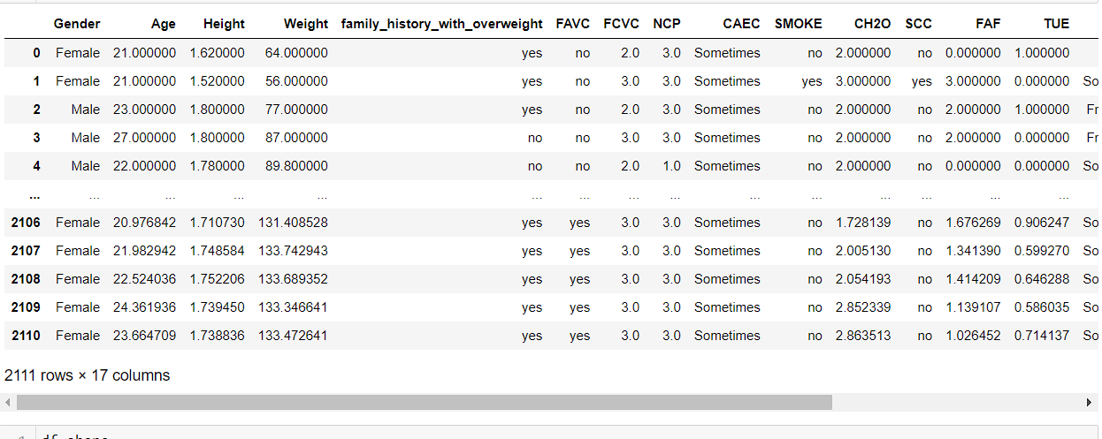
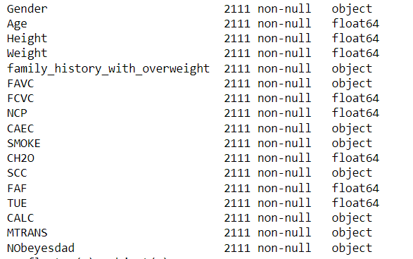
Data
It consists of variables like gender, whether a smoker or not and some other which tends to whether the person being obese or not.

Slide 7
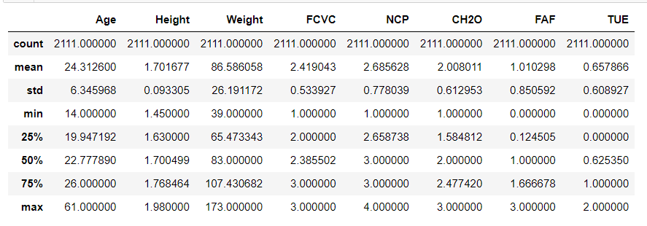
Statistical Description of Data

Slide 8
Literature Review
Goal: To build a classification report depicting the possibility of a person being obese.
Dataset: https://archive.ics.uci.edu/ml/datasets/Estimation+of+obesity+levels+based+on+eating+habits+and+physical+condition+
Methodology: Used classification algorithm to classify people who are obese basing on different factors and assigning any new person into any of the categories based on those factors.
Result: People who are into at least 40 mins of daily exercise and are not smokers are safe from obesity.

Slide 9
Literature review
"Prediction of Obesity in Young Adults Using Machine Learning: An Observational Study" by Pobłocka-Olech et al. (2020)
This study used machine learning models to predict obesity in young adults based on their lifestyle and dietary habits. The authors found that decision tree models achieved the highest accuracy in predicting obesity and identified important risk factors such as high-calorie food consumption, low physical activity, and high body mass index (BMI).
"Development and validation of a machine learning model for the early detection of obesity in children: a retrospective study" by Nguyen et al. (2020)
This study aimed to develop and validate a machine learning model to predict the likelihood of obesity in children. The authors found that their model achieved high accuracy in predicting obesity in children and identified important risk factors such as high-calorie food consumption, sedentary behavior, and parental obesity.
"Risk factors for childhood obesity: A Machine Learning Review" by Chiou et al. (2021)
This review article surveyed recent studies that used machine learning models to identify risk factors for childhood obesity. The authors identified several important risk factors such as parental obesity, dietary habits, sedentary behavior, and sleep patterns. They also discussed the potential of machine learning models to improve the accuracy of identifying risk factors for childhood obesity.

Slide 10
Literature Review
"Machine Learning Approaches for Predicting Obesity Risk in Adults: A Systematic Review" by Al-Emran et al. (2021)
This systematic review summarized recent studies that used machine learning models to predict obesity risk in adults. The authors identified several important risk factors such as BMI, dietary habits, physical activity, and sleep patterns. They also discussed the potential of machine learning models to improve the accuracy of identifying individuals at high risk of developing obesity.
Overall, these studies suggest that machine learning models can be useful for predicting the likelihood of developing obesity based on lifestyle and dietary habits. They also highlight the importance of identifying key risk factors associated with obesity to develop effective prevention and management strategies.

Slide 11
How would you predict obesity using these factors?
Classification Report is used to investigate the performance of each classifier in classes (level of obesity).
'Precision' shows the percentage of the classfier that is able to correctly predict the class. (i.e. True Positive / (True Positive + False Positive)
'Recall' shows the percentage of the actual positive cases that the classifer is able to identify. (i.e. True Positive / (True Positive + False Negative)
'F1' is the harmonic mean between Precision and Recall.
'Support' is the number of occurence of occurence of the given class in dataset. More consistent the number of 'Support' of each class is, the more balanced the dataset.

Slide 12
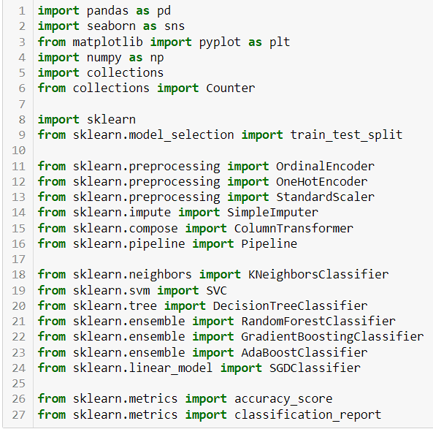
Importing Required Libraries

Slide 13
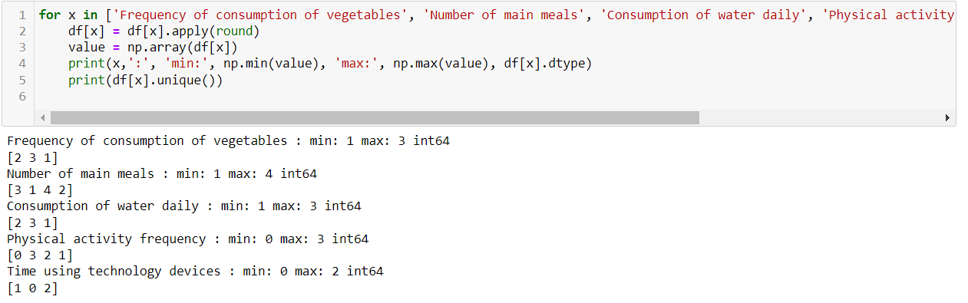
EDA

Slide 14
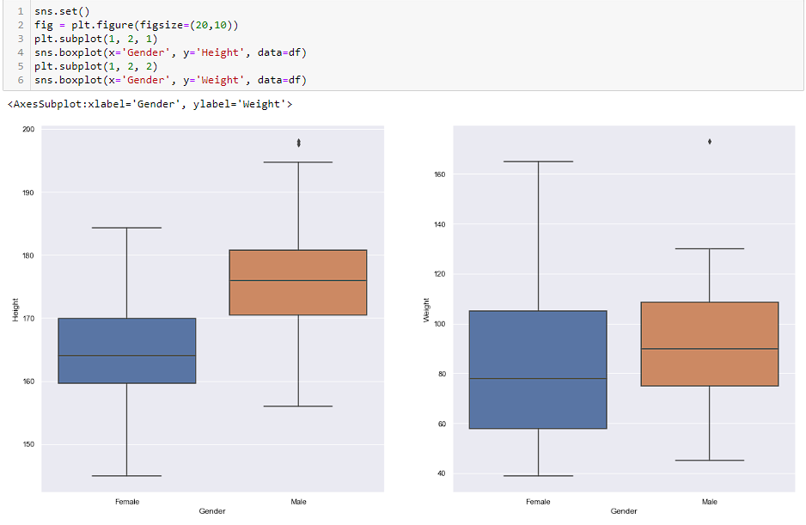
Insights from EDA

Slide 15
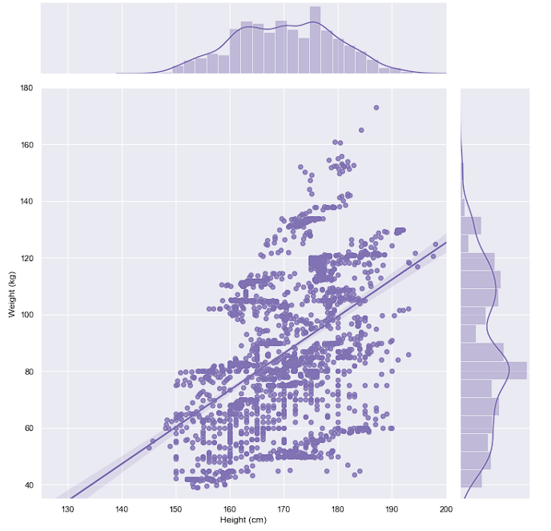
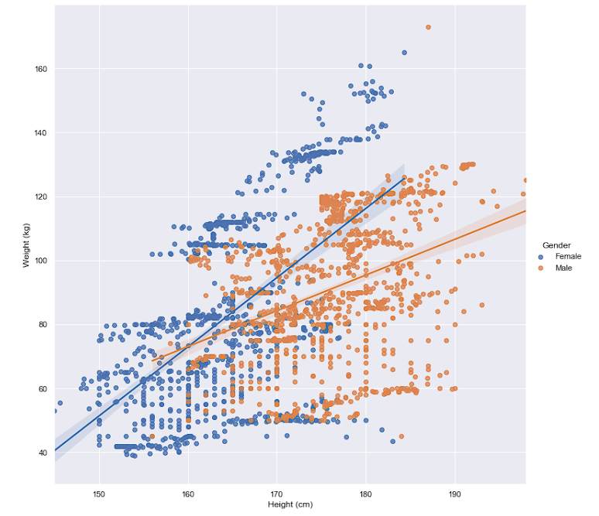
Insights from EDA

Slide 16
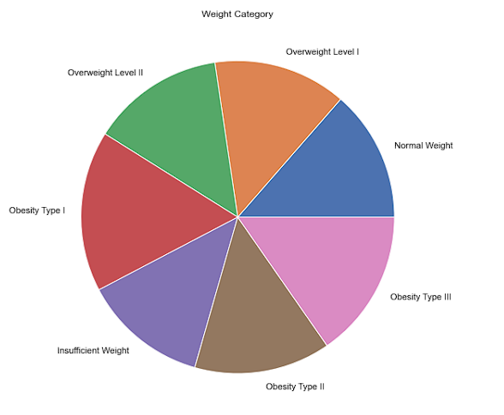
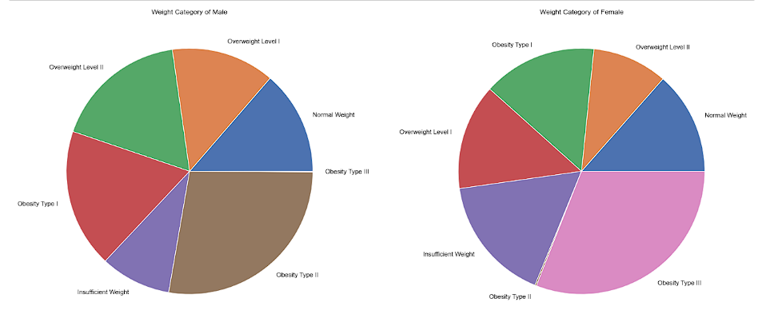

Slide 17
Thank you !

